Slide 1
Linear regression
Ezzeddin Alnajjar

Slide 2
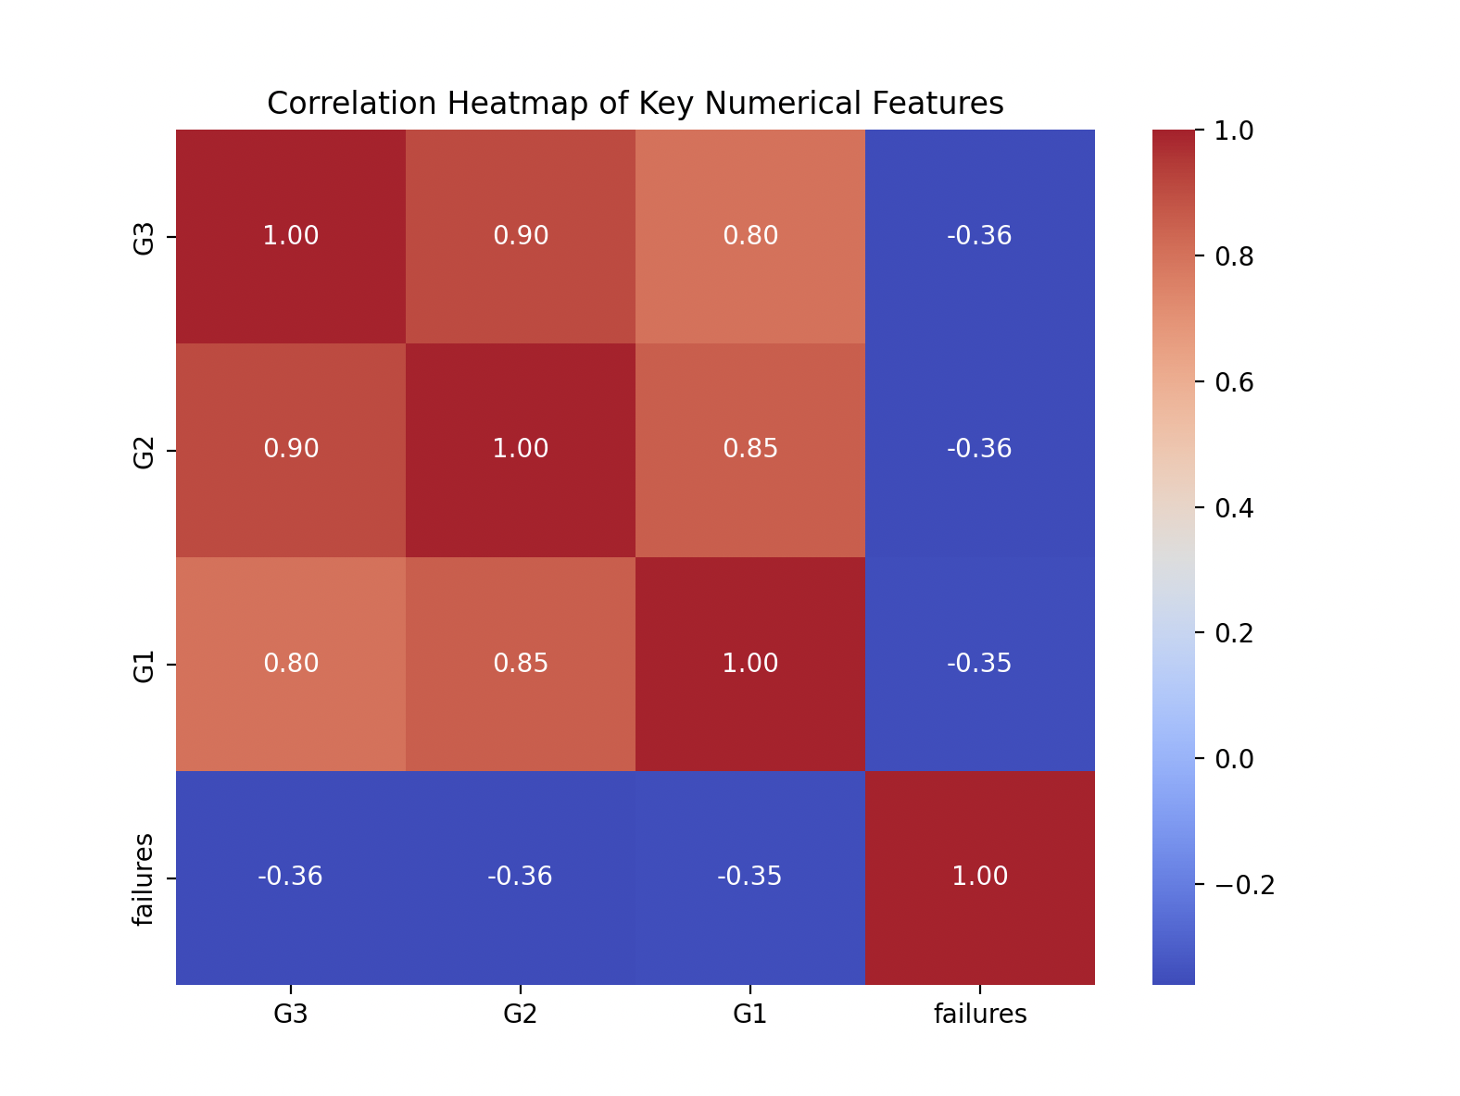
Attribute with strong correlation

Slide 3
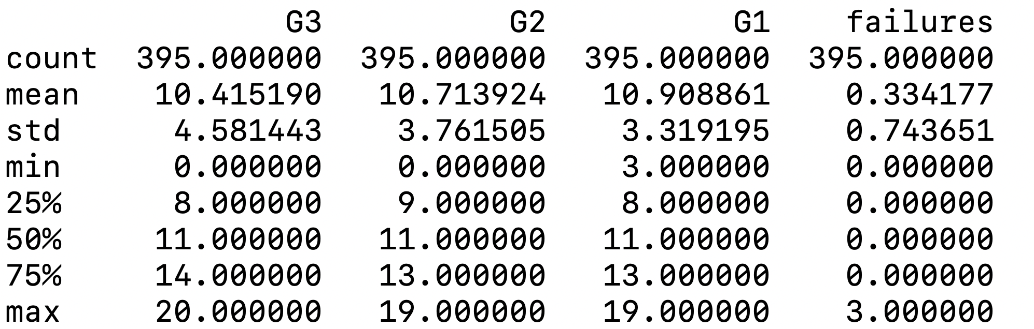
Descriptive Statistics

Slide 4
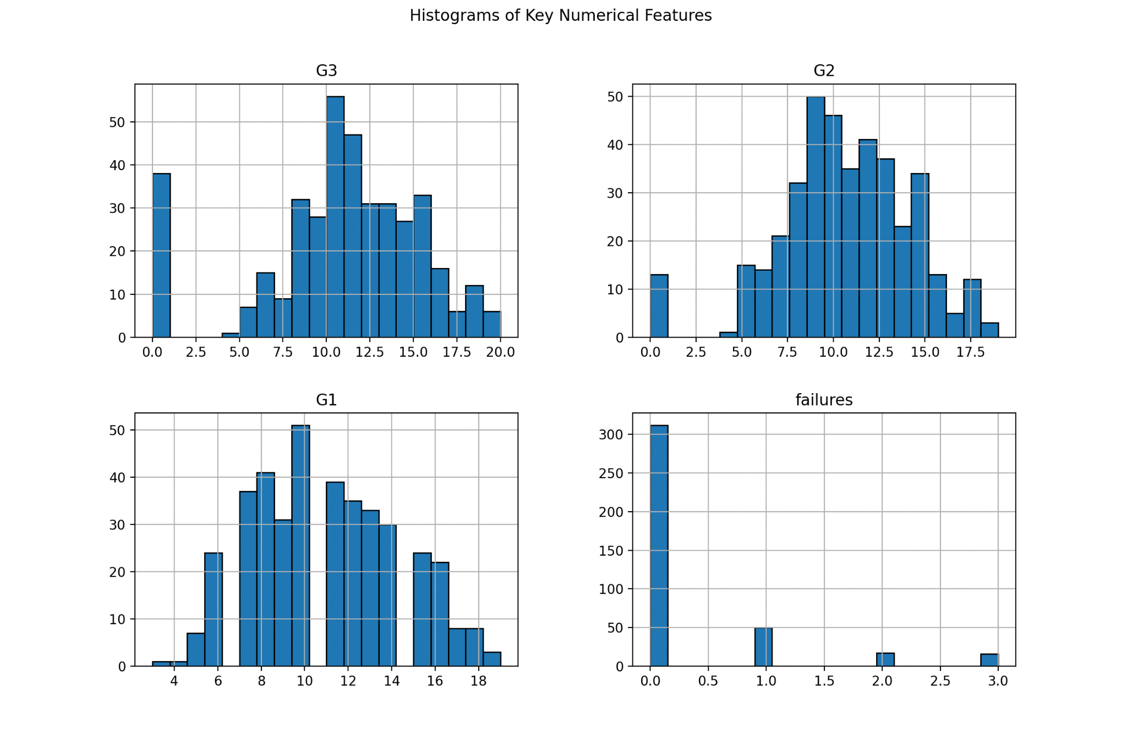
Histogram

Slide 5
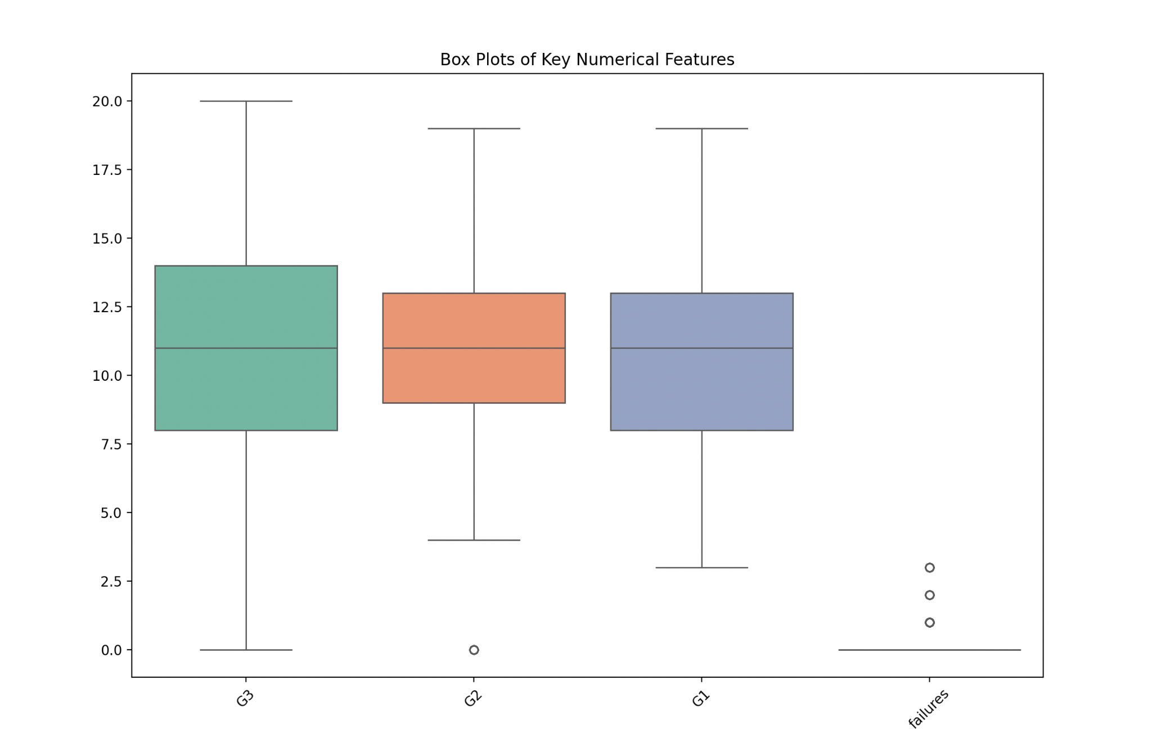
Box Plot

Slide 6
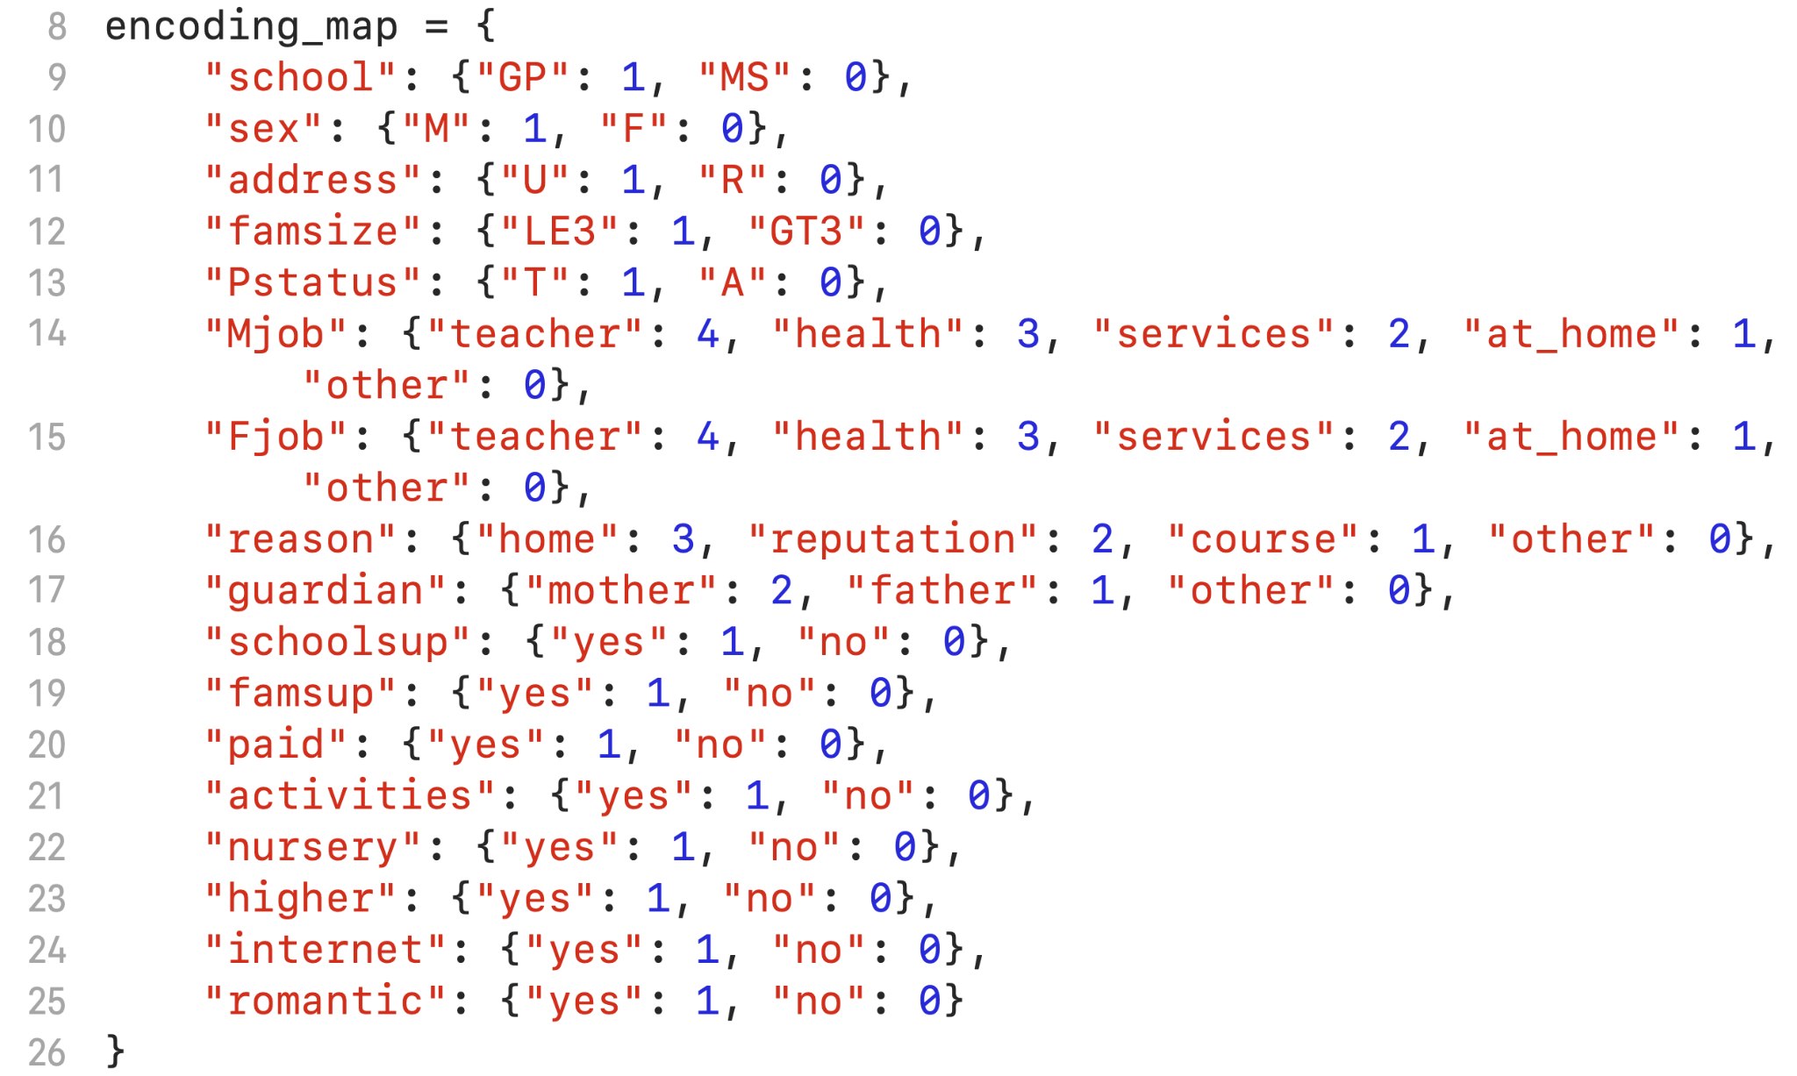
Encoding of categorical variable

Slide 7
Normalization or Standardization ?
Looking at the distribution and the structure of each attribute there is no need for Normalization nor Standardizations

Slide 8
Why Linear regression?
1) Simplicity
2) Predicting Continuous Values
3) Computational Efficiency

Slide 9
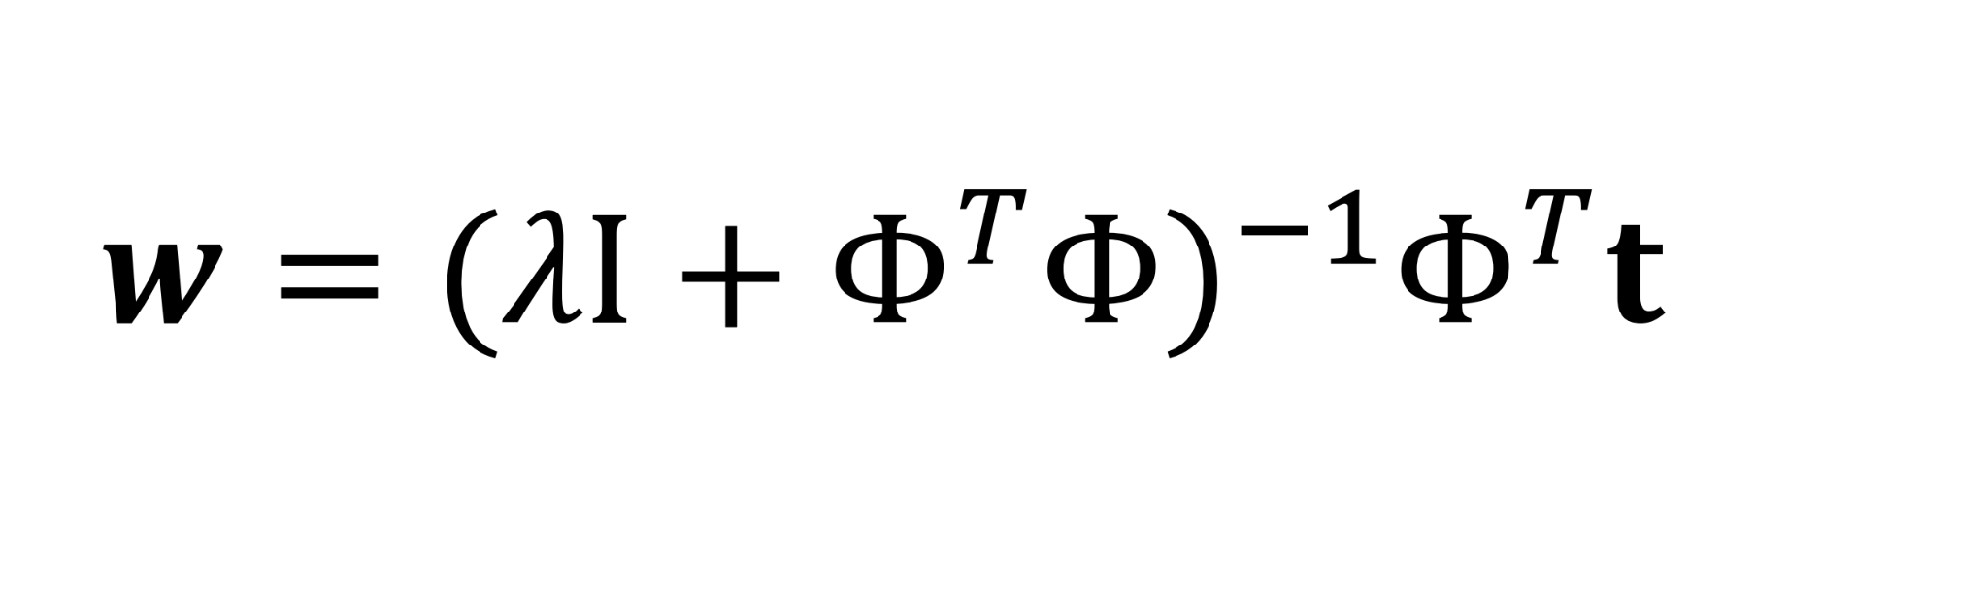
Training stage
formula for linear regression at the training stage

Slide 10

Testing stage
formula for linear regression at the testing stage

Slide 11
Performance of the model
Since the model splits the data randomly, its performance metrics will vary with each run. The observed range for the Mean Squared Error (MSE) is 3.37 to 5.10, while the R-squared (R²) score ranges from 0.74 to 0.82

Slide 12
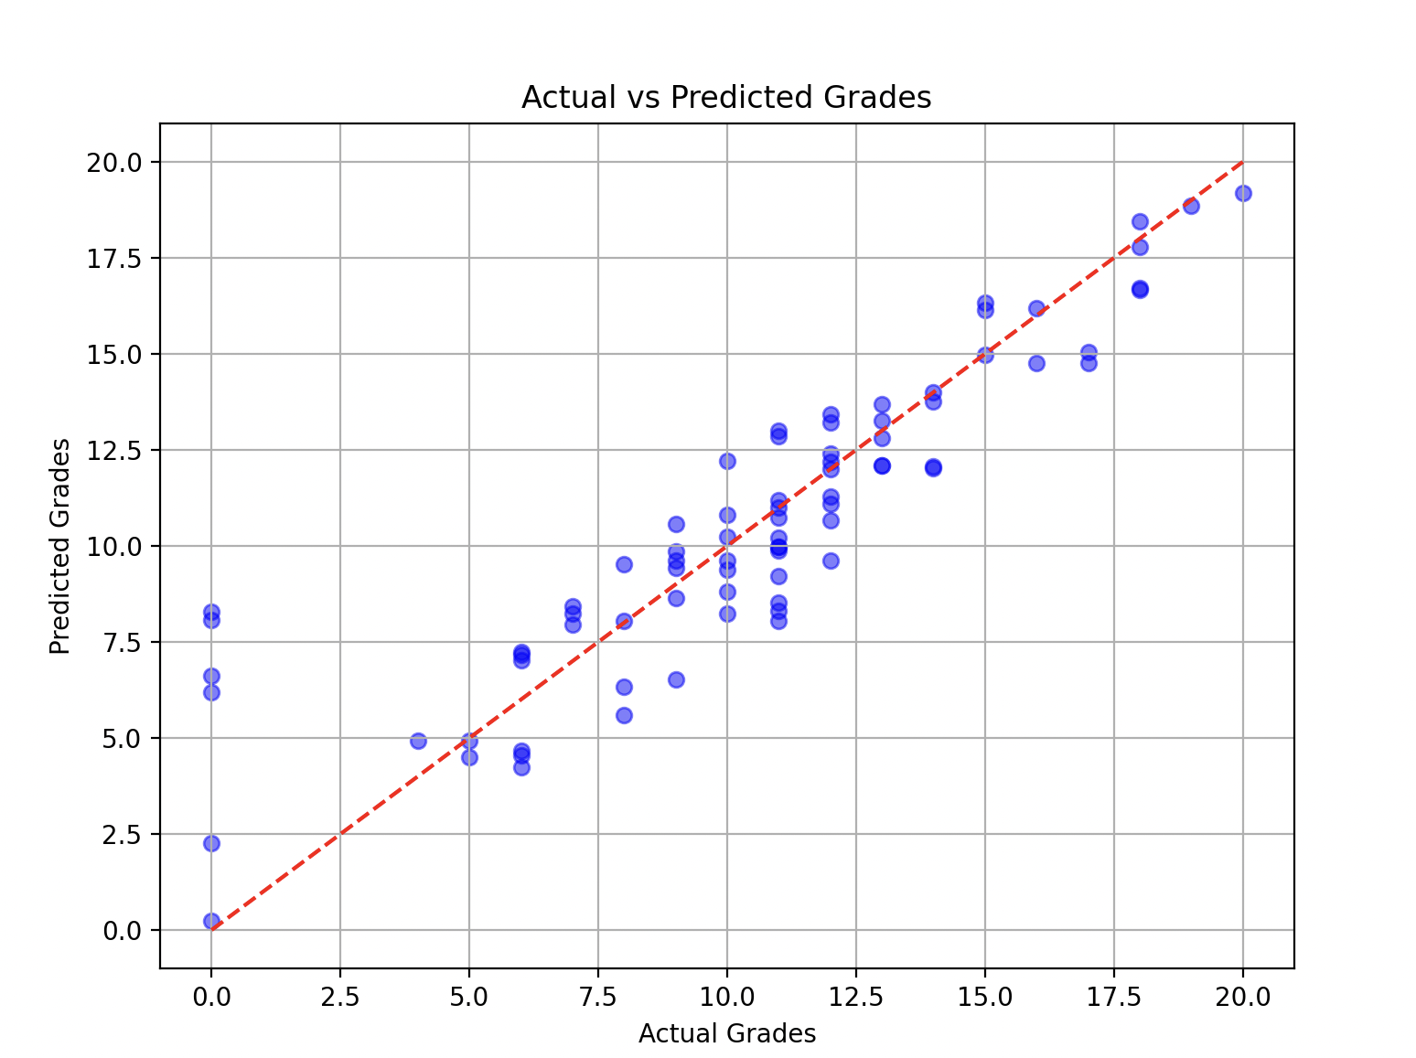
First run
MSE = 4.39
R^2 = 0.79

Slide 13
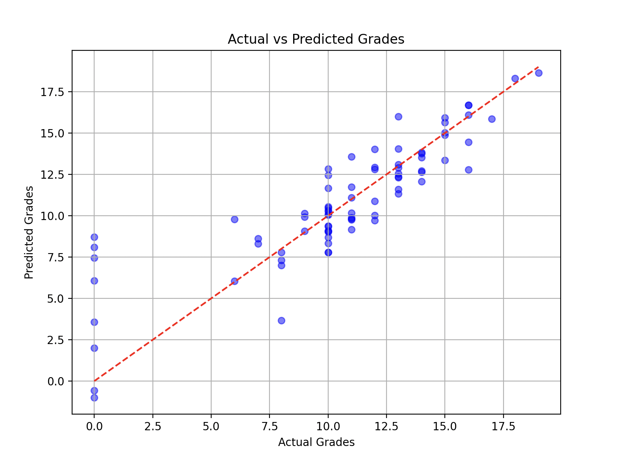
Second run
MSE = 5.10
R^2 = 0.74

Slide 14
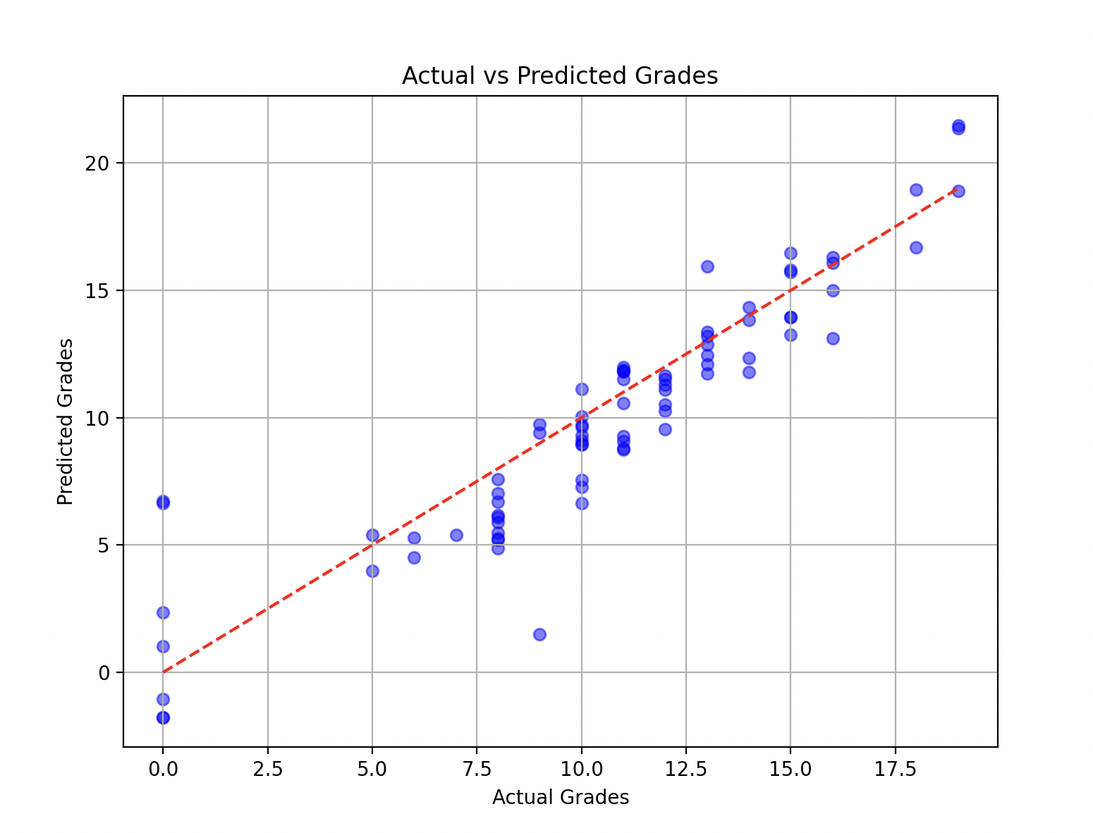
Third run
MSE = 4.13
R^2 = 0.80

Slide 15
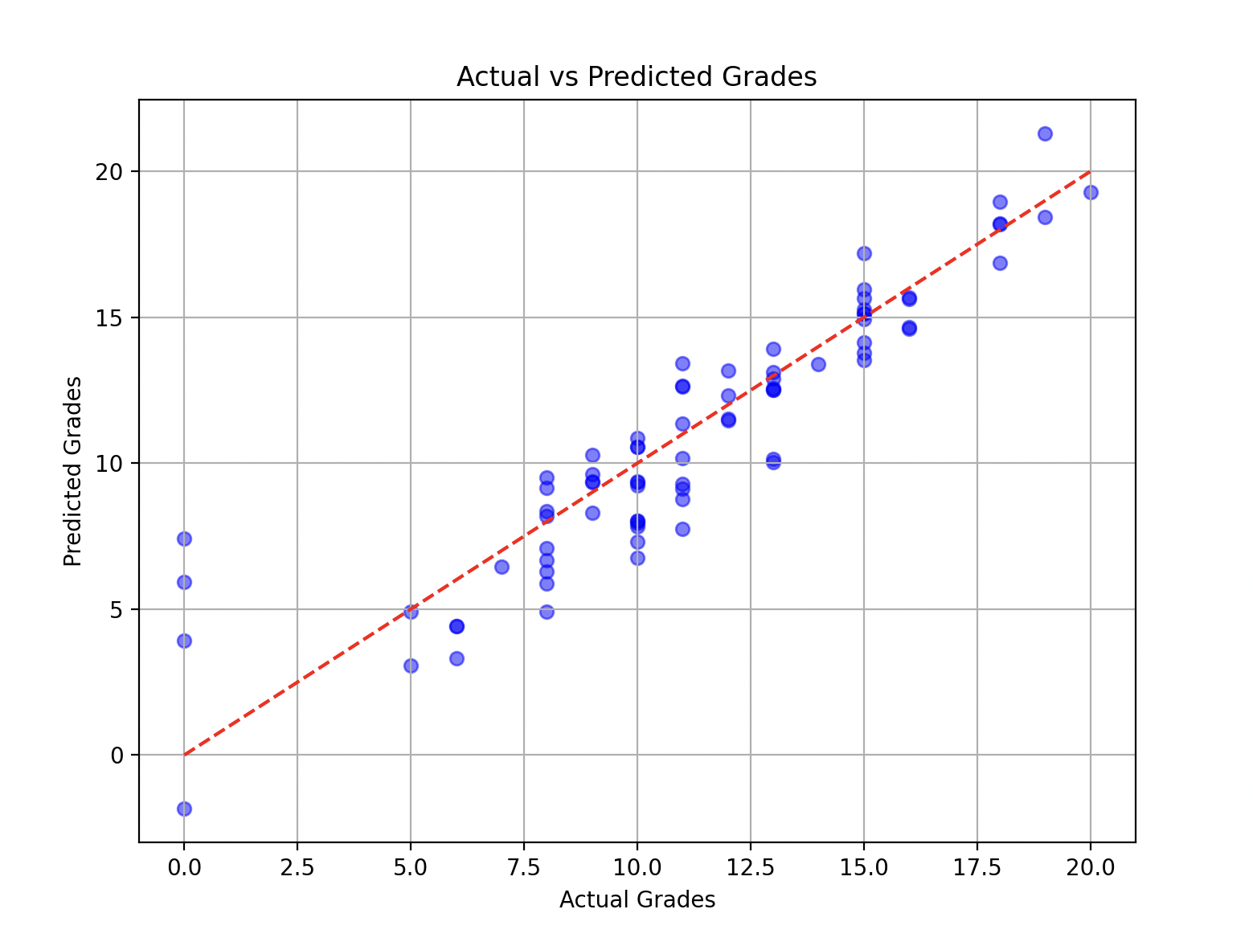
Fourth run
MSE = 3.37
R^2 = 0.82
Average MSE = 4.25
Average R^2 = 0.79

